Slide 1
CAPSTONE PROJECT
Presentation For Capstone
“App quản lý công ty BĐS”
Team 3: Hello World
Mentor: Đặng Đình Hòa

Slide 2
1.
Team introduction
Agenda
Agenda
2.
Project overview.
3.
Monitoring & control.
4.
Architectural.
5.
Summary test report.
6.
Risk management
7.
Problem project
8.
Lesson learned & Demo.

Slide 3
1. TEAM INTRODUCTION
LOGO TEAM
STAKEHOLDERS
Name | Role
Mr. Trần Minh Châu | Customer
Mr. Nguyễn Hữu Nhật | Customer

Slide 4
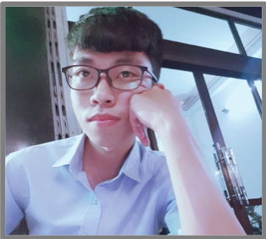
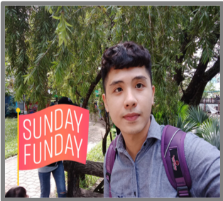
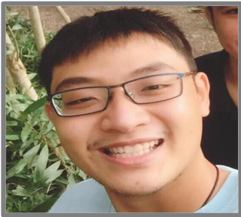

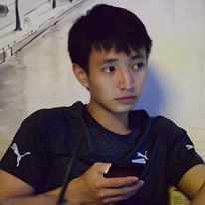
TEAM MEMBER
Huỳnh Tuấn Đạt
Trương Quang Vương
Phạm Quốc Nhân
Trịnh Nhu Phương
Nguyễn Anh Minh
CODER
CODER
DESIGNER
TESTER
CODER
4

Slide 5
2. Project overview
Project introduction
Currently, housing demand is a big problem for people across the country, so homeowners are looking to provide housing through real estate applications.
Real Estate App, built for internal users to manage projects, manage statistics, reports and many other functions.
The App also helps employees know more about essential information about the real estate industry such as real estate projects, employee sales, group and room sales.
5

Slide 6
2. Project overview
Number of people in the company
Stakeholders | Number of people
Director | 1 people
Department Heads | ~10 people
Administrator | ~1 people
Employees | ~150 people
Deputy department | ~5 people
6

Slide 7
2. Project overview
Business constraints
# | Business Rules | Business Rules
1 | BR1 | When employees leave, the account will be hidden.
2 | BR2 | Staff only view and register applications
3 | BR3 | Only the administrator can update the information
4 | BR4 | Only director can approve employee applications
5 | BR5 | Unapproved applications will be canceled and not saved in history
6 | BR6 | Admin to update information continuously or when there is information from leaders and departments
7 | BR7 | Admin cannot use App Mobile to import files, etc.
7

Slide 8
2. Project overview
Technical constraints
System: | Programming language App: | Programming language Website: | Database: | Communication
Website (browser: Firefox, Chrome, Cốc cốc,..) | Code: Javascript | Code: javascript | Database: Firebase | Zalo and facebook
App (platform: Ios & Android). | Framework: React native | Framework: Vuejs | Document: github
8

Slide 9
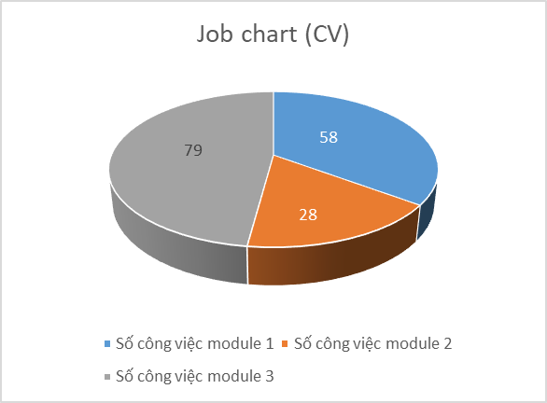
3. Monitoring & control
Job chart
Total work for module 1 | 58
Total work for module 2 | 28
Total work for module 3 | 79
9

Slide 10
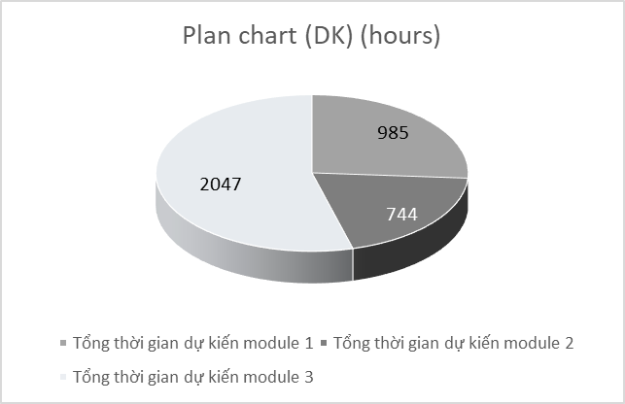
3. Monitoring & control
Plan chart (DK) (hours)
Total actual time of module completion 1 | 985 hours
Total actual time of module completion 2 | 744 hours
Total actual time of module completion 3 | 2047 hours
10

Slide 11
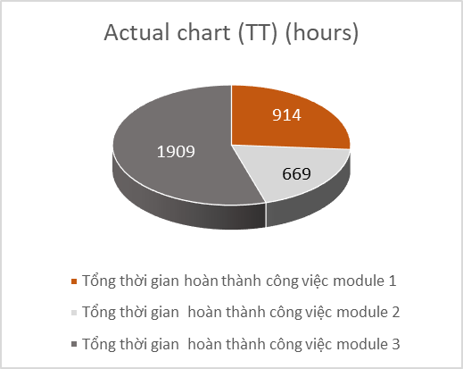
3. Monitoring & control
Actual chart (TT) (hours)
Total actual time of module completion 1 | 914 hours
Total actual time of module completion 2 | 669 hours
Total actual time of module completion 3 | 1909 hours
11

Slide 12
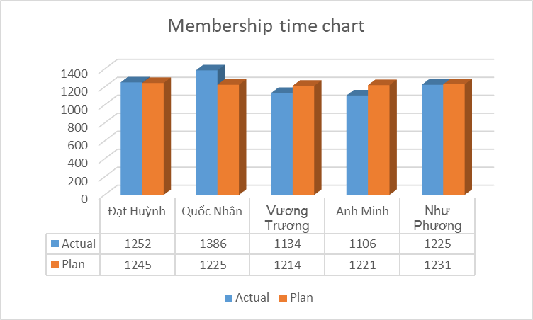
3. Monitoring & control
Membership time chart
Total time each member worked in 32 weeks
12

Slide 13
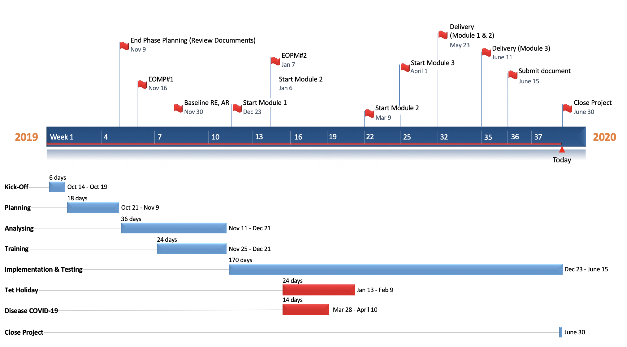
3. Monitoring & control
13

Slide 14
4. Architectural
# | ID | Quality Attributes | Priority
Usability
1 | QA1 | Users use the app to easier | High
Portability
2 | QA2 | Users can use the application on two platforms | High
14

Slide 15
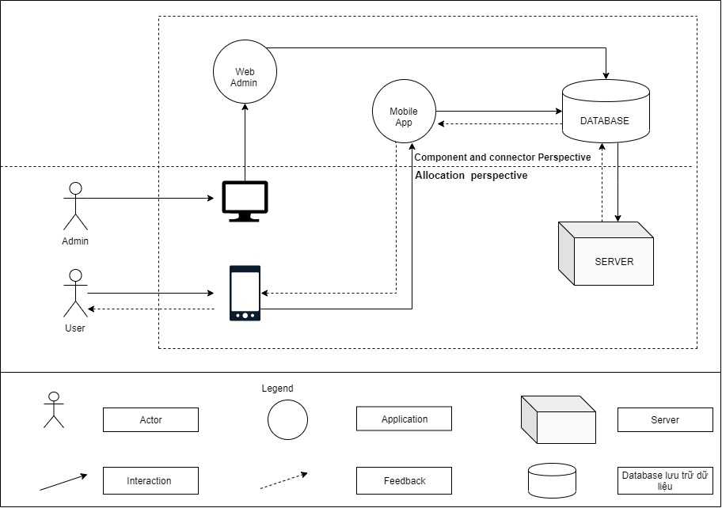
4. Architectural
Context diagram
15

Slide 16
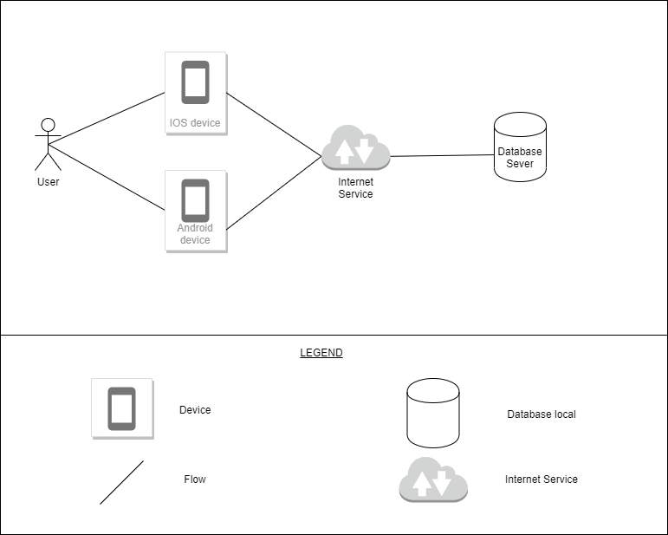
4. Architectural
Protability (physics)
16

Slide 17
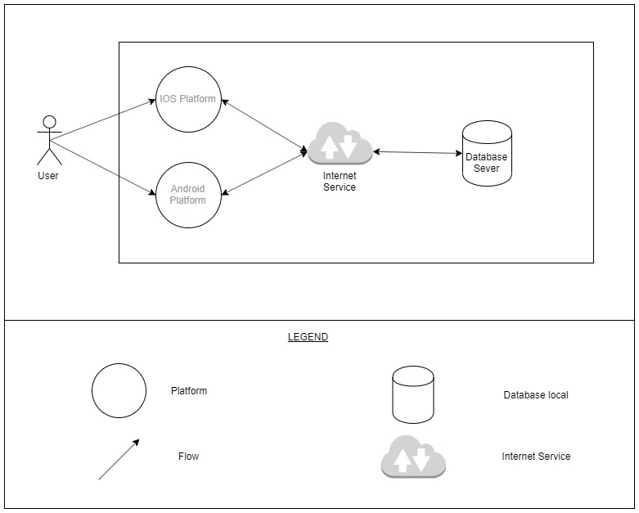
4. Architectural
Protability (dynamic)
17

Slide 18
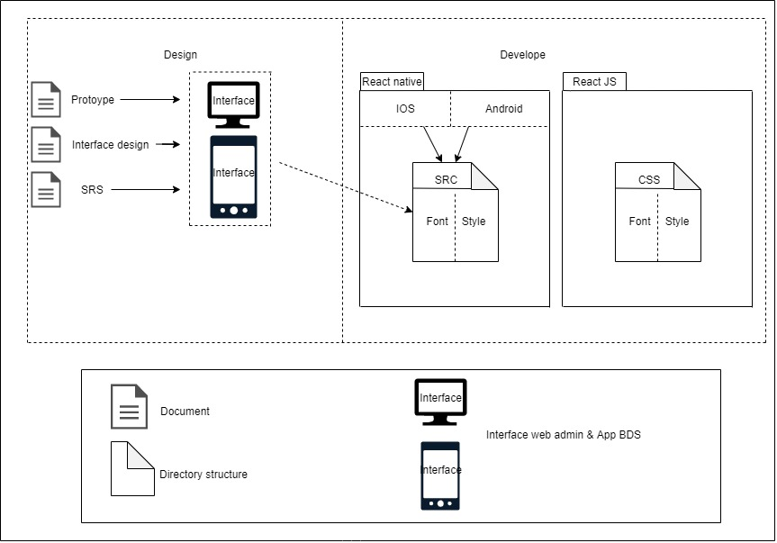
4. Architectural
Usability (static)
18

Slide 19
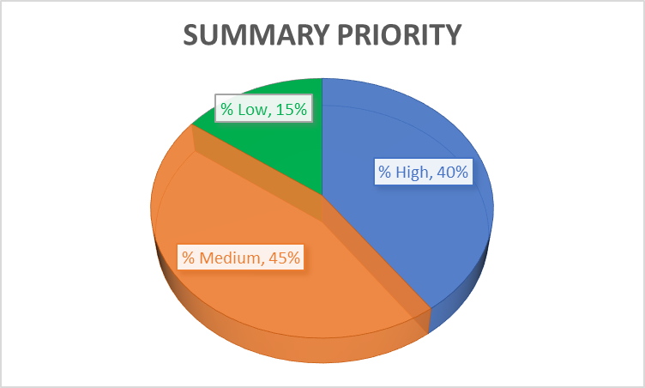
5. Summary test report.
Summary priority
19

Slide 20
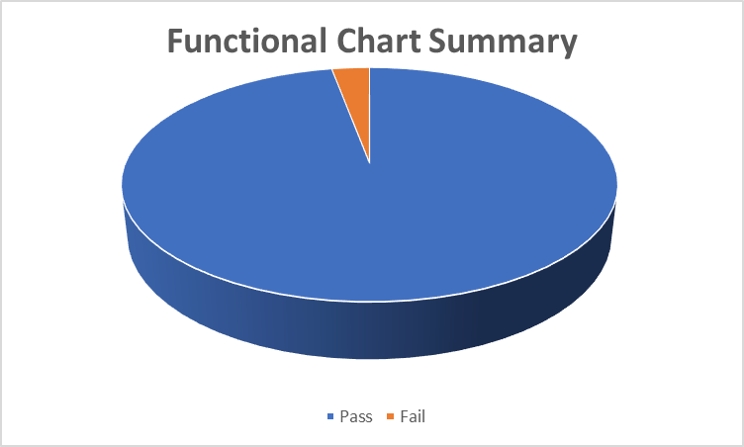
5. Summary test report.
Summary priority
Summary
Pass | 361
Fail | 11
Number of test cases | 372
20

Slide 21
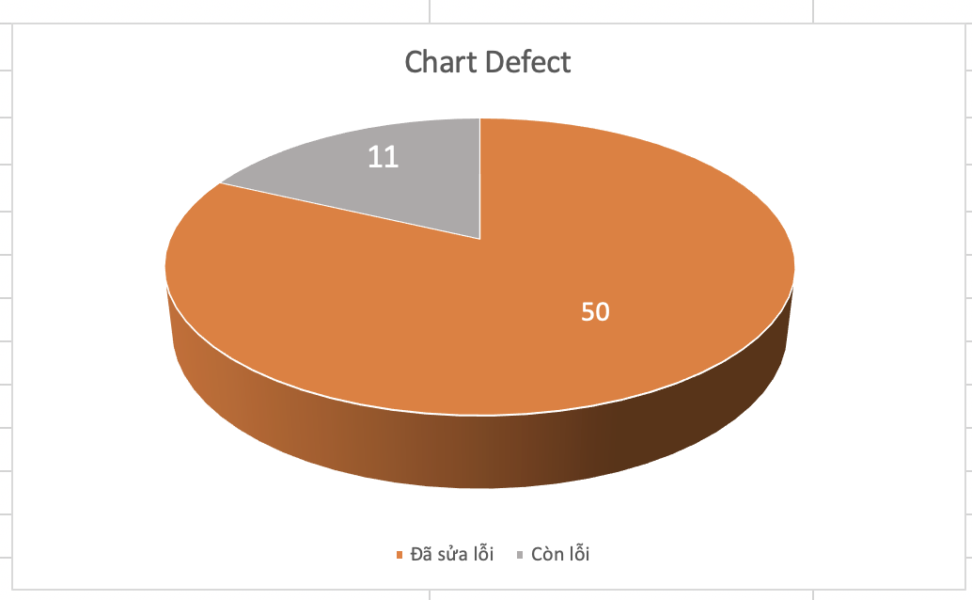
5. Summary test report.
Summary priority
Summary
Execution | 100%
Error found | 61
Corected the error | 50
Error still | 11
21

Slide 22
7. Risk management
Number | Risk name | Possibility | Impact | Priority | How to prevent or minimize
1 | Difficulties with new technologies | Moderate | Moderate | Moderate | 1. Organize training sessions on new technologies for all members
2 | Lost data | High | High | High | 1. Online storage 2. Create a backup file
3 | Machinery and equipment had problems during the project's implementation | Moderate | Moderate | Moderate | 1.Implementation on many devices
4 | Performance is not guaranteed | High | High | High | 1. Keep members in the best state 2. Regularly interested and updated the working situation of the members.
22

Slide 23
7. Risk management
Number | Risk name | Possibility | Impact | Priority | How to prevent or minimize
5 | Customer change | High | Moderate | Moderate | 1. Having a contract, a written signature of the customer for specific requirements upon project receipt. 2. There is a specific process for customer change
6 | Member left the project | High | High | High | 1. Ensure all members are fully involved in the work of the project. 2. Regular meetings (outside work) to build solidarity 3. Having a mechanism to manage and archive work documents of all members.
7 | Members have unequal qualifications | High | High | High | 1. Training members from the beginning of the project. 2. Organize cross-training sessions for members.
23

Slide 24
7. Problem project
Number | Problem name | Possibility | Impact | Impact factor | How to fix
1 | Language code | High (occurred) | High | Objective | Spend much time for search (Forum, youtube, google, group facebook, question mentor, …)
2 | Database (firebase) | High (occurred) | High | Objective | Spend much time for search (Forum, youtube, google, group facebook, question mentor, …)
3 | Change requirement | Medium (occurred) | Medium | Objective | Contract signed (increased time)
4 | Disease cov19 | High (occurred) | High | Objective | Meeting online
24

Slide 25
8. Lesson learned & Demo.
Lesson learned
Knowledge - skills
1 | Design - Deeper understanding of design. Have more knowledge about doing real projects
2 | Code - Gain new knowledge of programming languages and practical project experience
3 | Test - Understand the importance of a tester and also get hands-on experience
Teamwork
1 | Very good teamwork team without any difficulties.
2 | Everyone has responsibility and a sense of not pushing things
3 | There are recreational activities to improve team spirit
25

Slide 26
8. Lesson learned & Demo.
26

Slide 27
THANK YOU

